Slide 1

To-Do List
Work at time.

Slide 2
Our Group Members:
NAME
UID
MANPREET SINGH 20BCS5638
HARSHIT MISHRA 20BCS5637 RISHABH HANS 20BCS5597 ABHIJEET KUMAR 20BCS5587

Slide 3
What is To-Do List
This Project “To-Do-List” helps the users to complete their tasks and activities on time. The Project is designed using various coding languages such as HTML, CSS, Java-Script, and React. When you complete a task, you can cross it off your list. This gives you a sense of progress and achievement, something you’ll lack if you’re always rushing from one task to the next. If you feel a sense of achievement, it spurs you on and motivates you to keep moving forward. Mark the importance of the task next to it, with a priority from A (very important) to F (unimportant). Redraft the list into this order of importance. Then carry out the jobs at the top of the list first. These are the most important, most beneficial tasks to complete. Some other important points: Improves your Memory, Improves Productivity, and Helps with motivation.

Slide 4
Objectives:
The primary purpose of a to-do list isn’t to get everything done. No, the primary purpose of a to-do list is to set your mind at ease that you know what your responsibilities are. That’s the main reason you should keep one.
• To-do lists offer a way to increase productivity, stopping you from forgetting things, help prioritize tasks, manage tasks effectively, use time wisely, and improve time management as well as workflow.
• A close second is that is this: a to-do list helps prevent your most urgent things from slipping through the cracks—it prevents you from dropping any major balls. That’s because any good to-do list allows you to emphasize your highest priority items.

Slide 5
Technology Used:
HTML
CSS
Java-Script

Slide 6
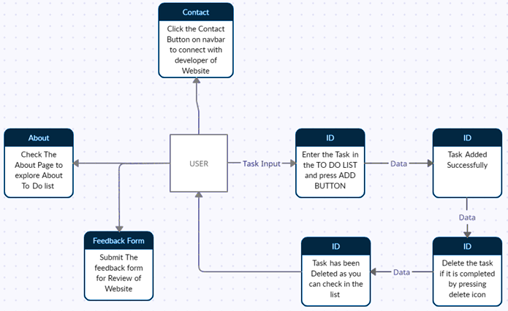
Data Flow Diagram

Slide 7
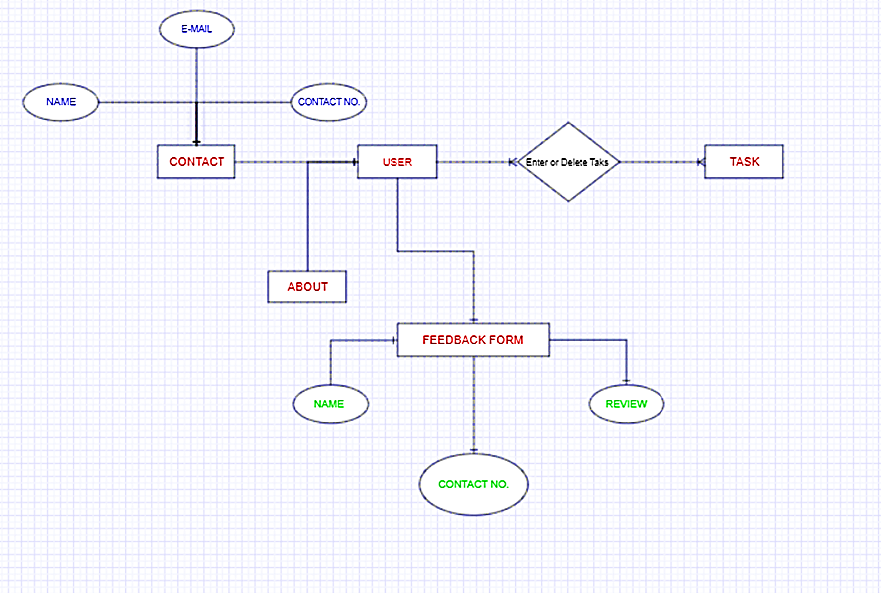
ER-Diagram

Slide 8
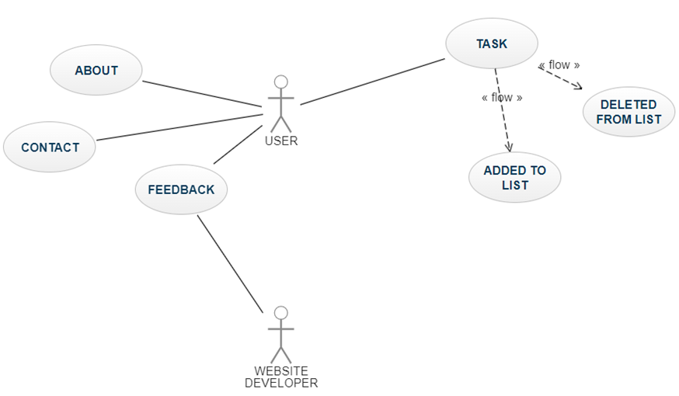
Use Case Diagram

Slide 9
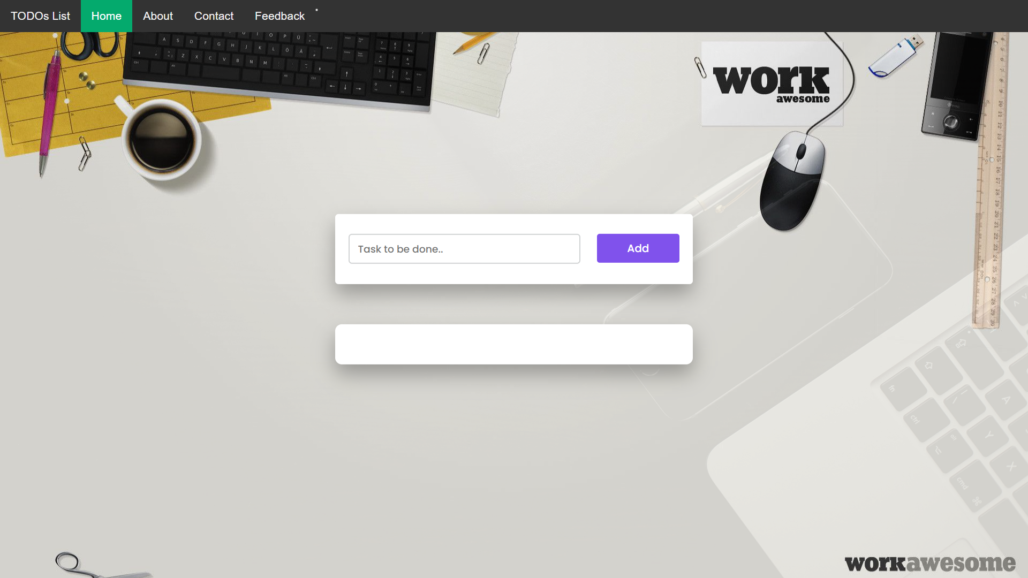
HOME PAGE

Slide 10
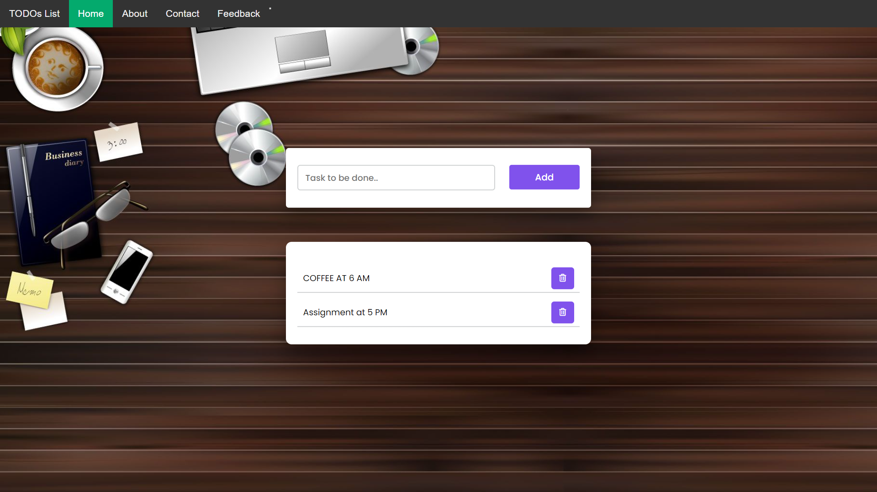

Task added to list
SIMPLE TO USE
Click on a bin to delete the task.

Slide 11
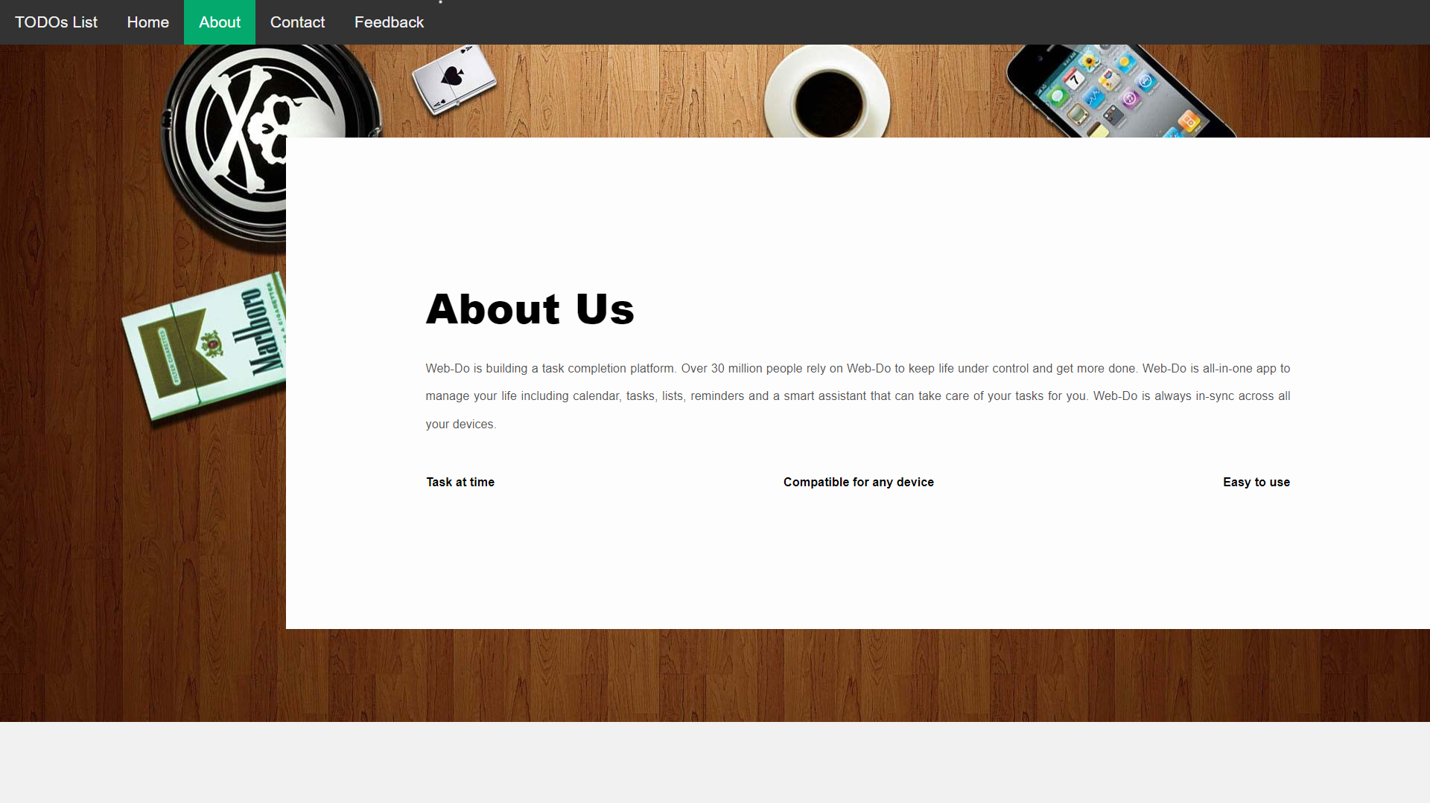

Slide 12
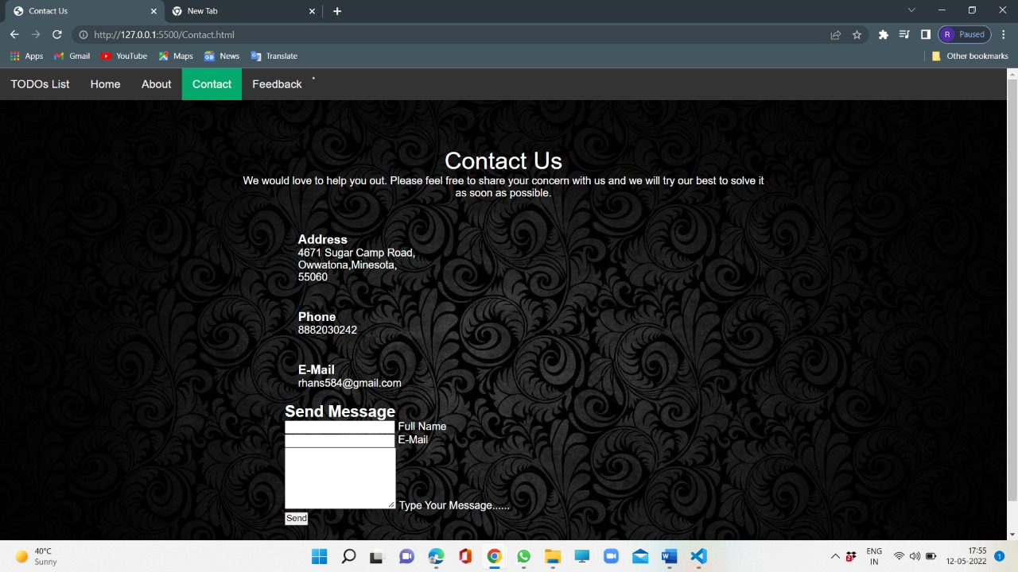

Slide 13
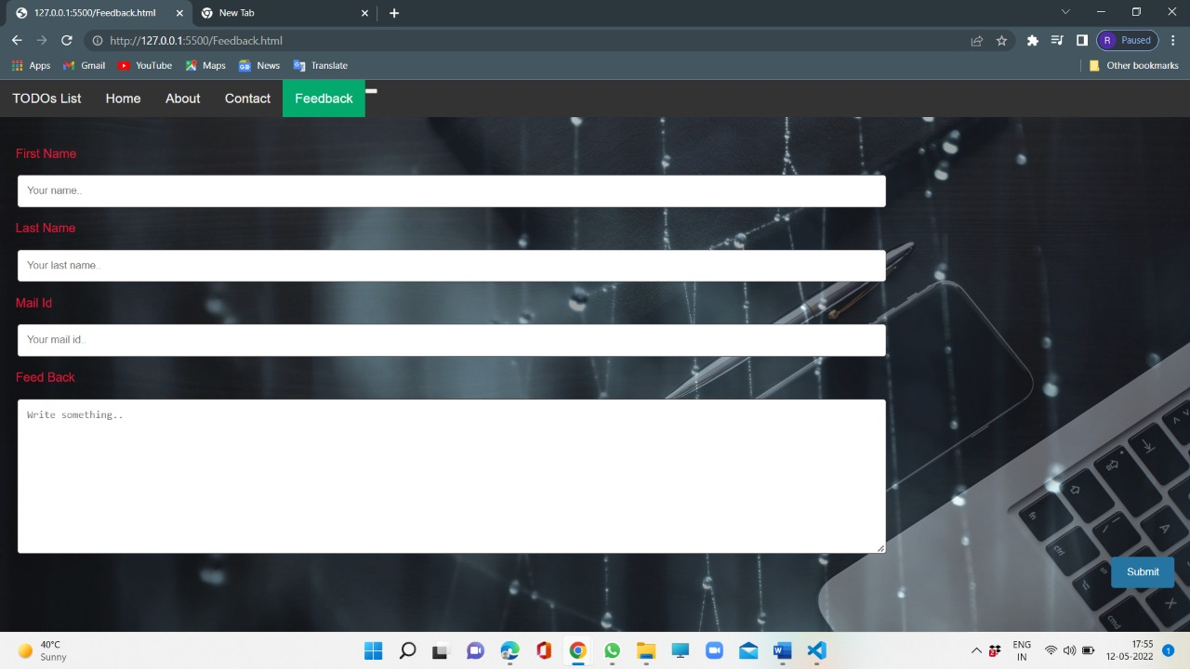

Slide 14
OUTCOMES
Website: We have created a TODO’s List Website using Modern day Technologies such as HTML, CSS, and Java-Script. It is a well-designed Website and functional as well.
PPT: A Presentation that depicts the overall Project details.
Some of the Goals attained through this project are as follows: -
Increases Productivity
Provides Motivation
Reduce Stress
Reduces Anxiety and Improves Mental Health
Provides a Sense of Accomplishment

